Slide 1

Angular
Developing SPA with Angular 12
DATE
29th June 2021

Slide 2
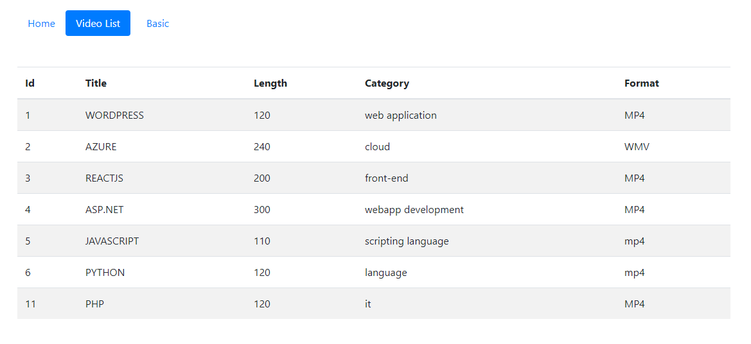

Slide 3
Template
Component
Module
Bindings- 4 types
Directives
Decorators
Hooks
Services
Dependency injection
Routing
observables
Angular Application architecture

Slide 4
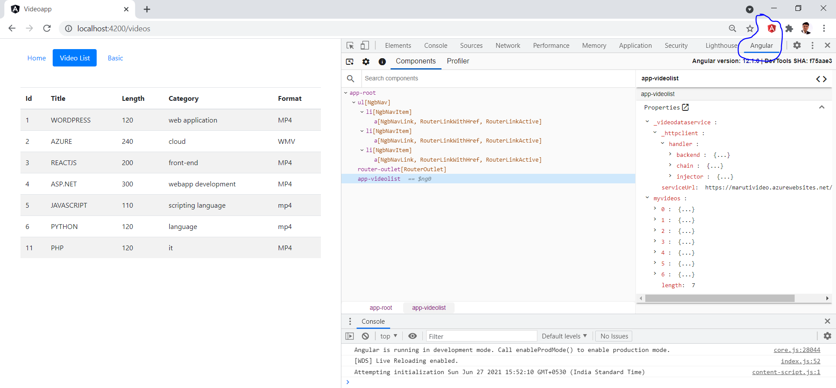
Angular devtools

Slide 5
approuting
browser
httpclient
forms
ngbmodule
appmodule
basic
Home
appcomponent
videolist
videodataservice

Slide 6
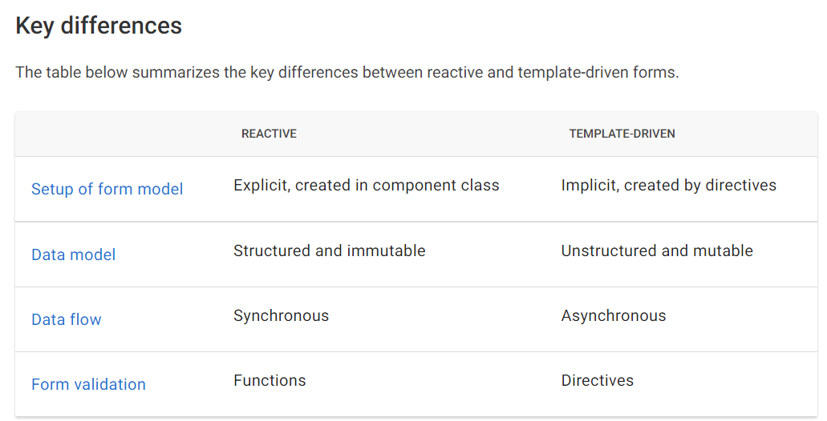

Slide 7
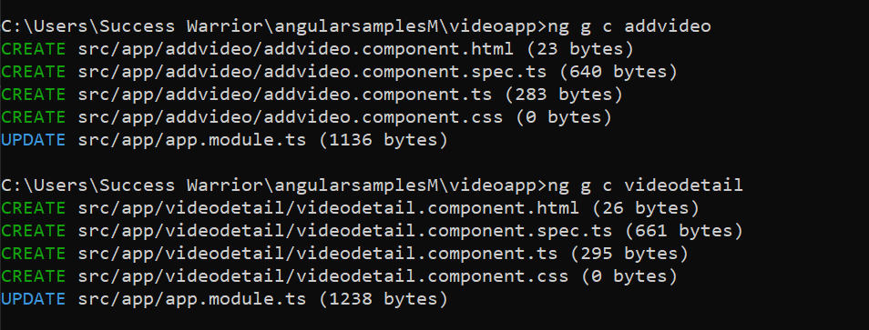

Slide 8
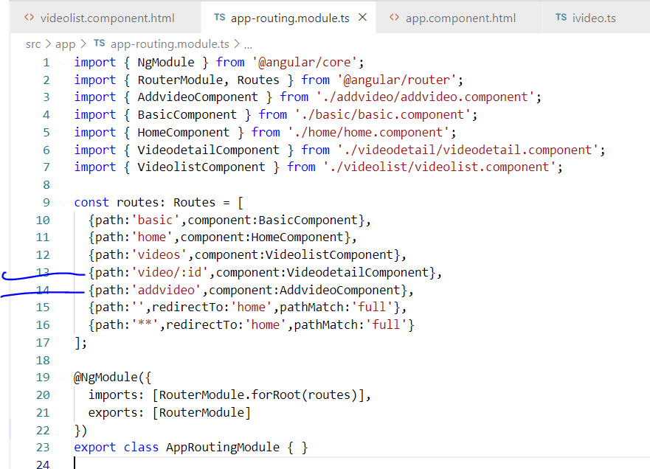

Slide 9
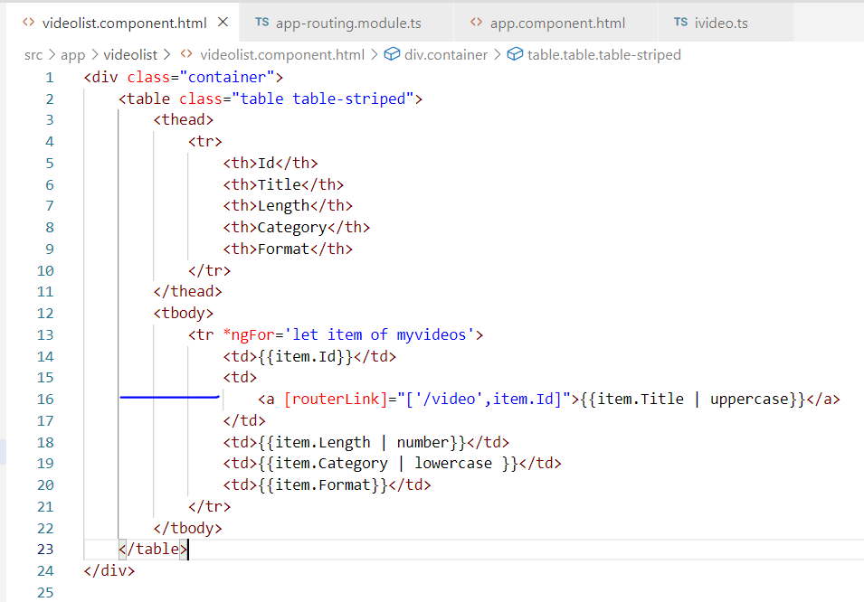

Slide 10
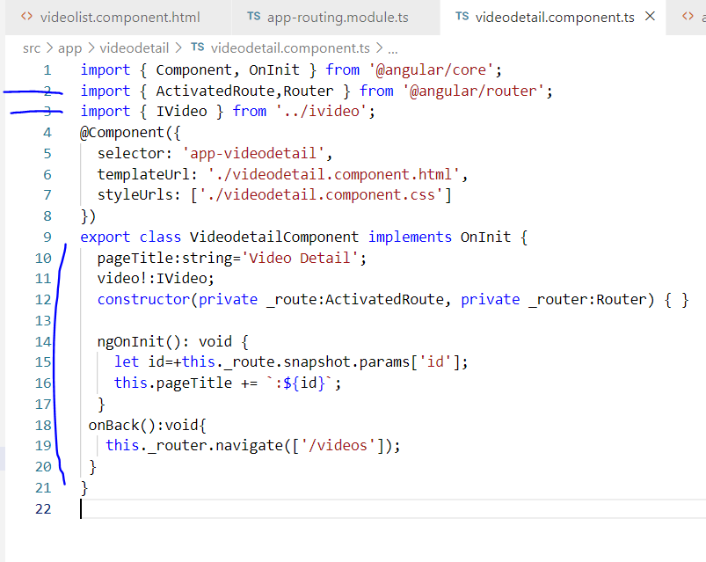

Slide 11
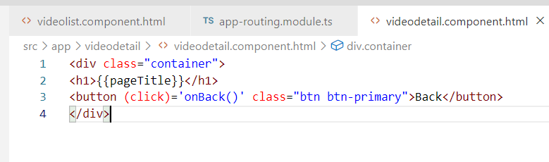
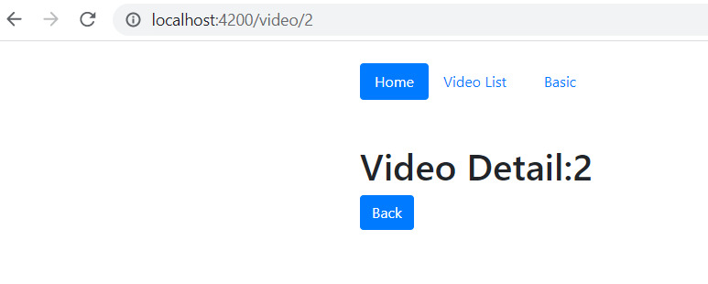

Slide 12
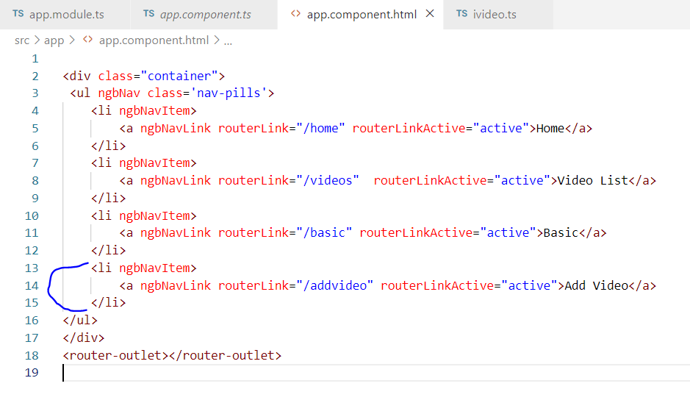

Slide 13
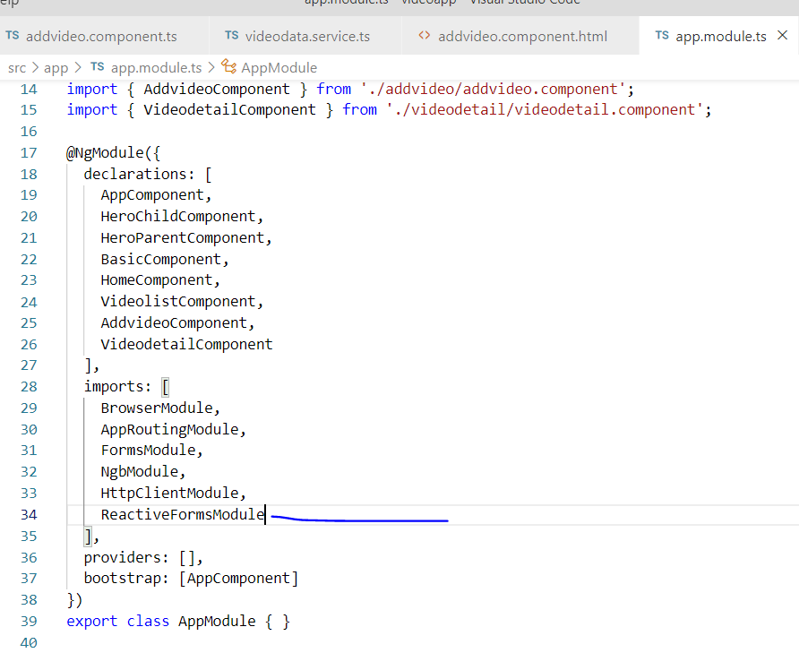

Slide 14
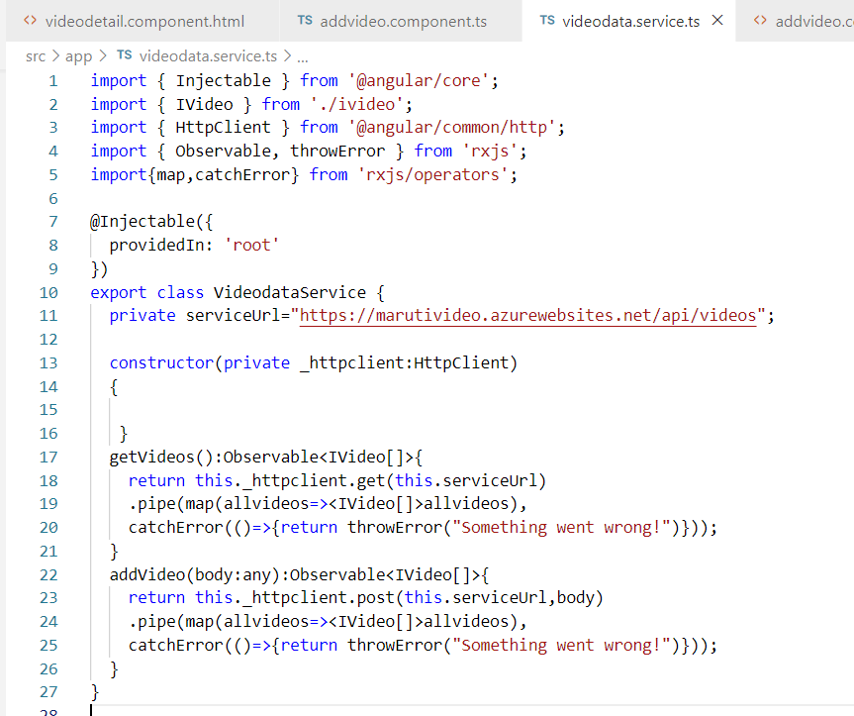

Slide 15
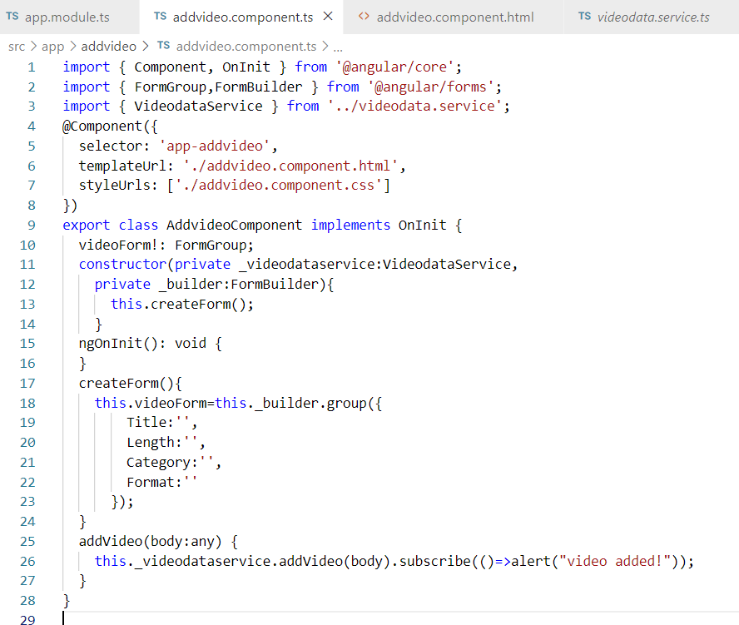

Slide 16
import { Component, OnInit } from '@angular/core';
import { FormGroup,FormBuilder, Validators } from '@angular/forms';
import { VideodataService } from '../videodata.service';
@Component({
selector: 'app-addvideo',
templateUrl: './addvideo.component.html',
styleUrls: ['./addvideo.component.css']
})
export class AddvideoComponent implements OnInit {
videoForm!: FormGroup;
constructor(private _videodataservice:VideodataService,
private _builder:FormBuilder){
this.createForm();
}
ngOnInit(): void {
}
createForm(){
this.videoForm=this._builder.group({
Title:'',
Length:'',
Category:'',
Format:''
});
}
addVideo(body:any) {
this._videodataservice.addVideo(body).subscribe(()=>alert("video added!"));
}
}

Slide 17
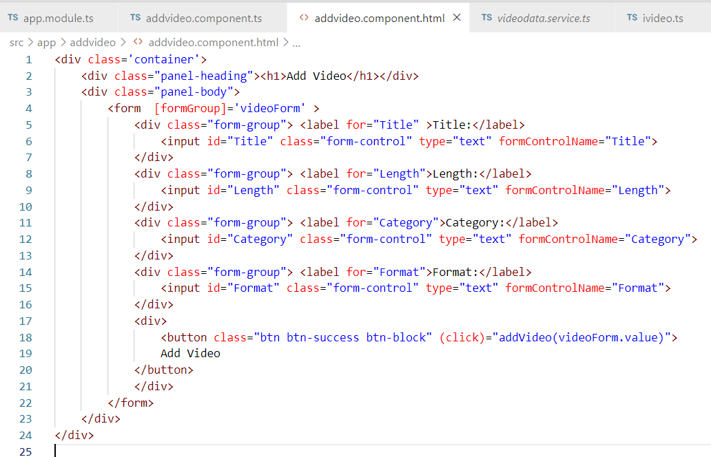

Slide 18
<div class='container'>
<div class="panel-heading"><h1>Add Video</h1></div>
<div class="panel-body">
<form [formGroup]='videoForm' >
<div class="form-group"> <label for="Title" >Title:</label>
<input id="Title" class="form-control" type="text" formControlName="Title">
</div>
<div class="form-group"> <label for="Length">Length:</label>
<input id="Length" class="form-control" type="text" formControlName="Length">
</div>
<div class="form-group"> <label for="Category">Category:</label>
<input id="Category" class="form-control" type="text" formControlName="Category">
</div>
<div class="form-group"> <label for="Format">Format:</label>
<input id="Format" class="form-control" type="text" formControlName="Format">
</div>
<div>
<button class="btn btn-success btn-block" (click)="addVideo(videoForm.value)">
Add Video
</button>
</div>
</form>
</div>
</div>

Slide 19
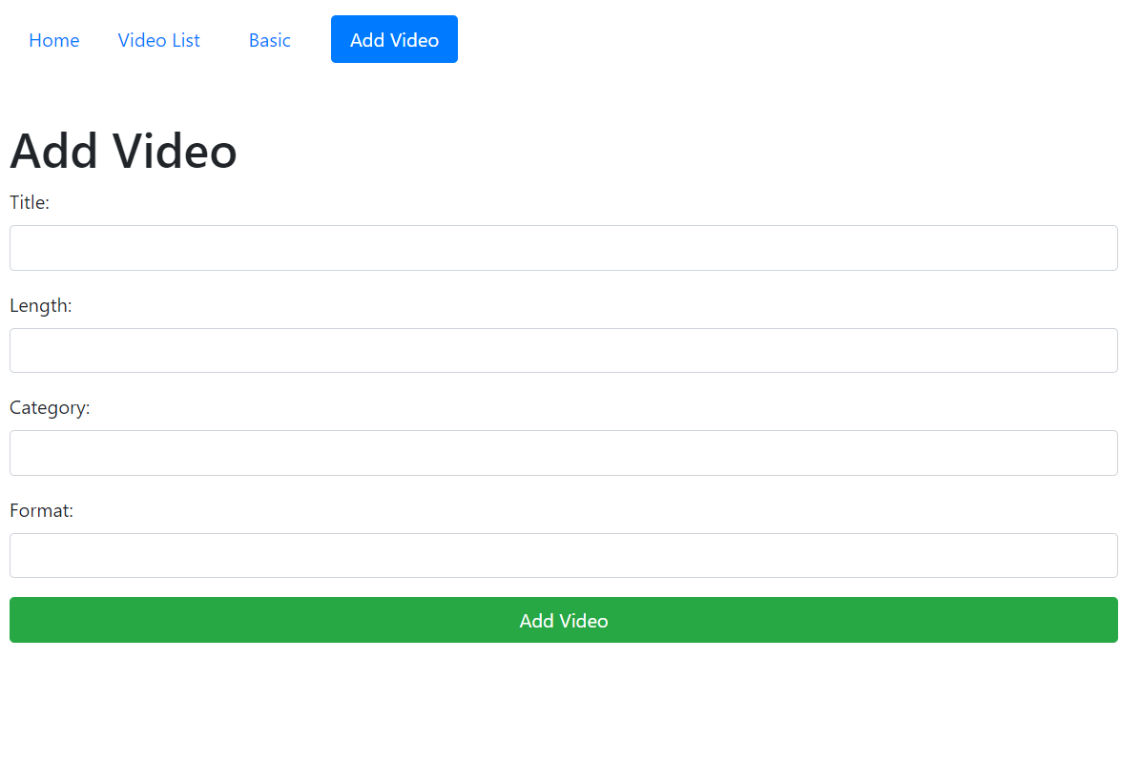

Slide 20
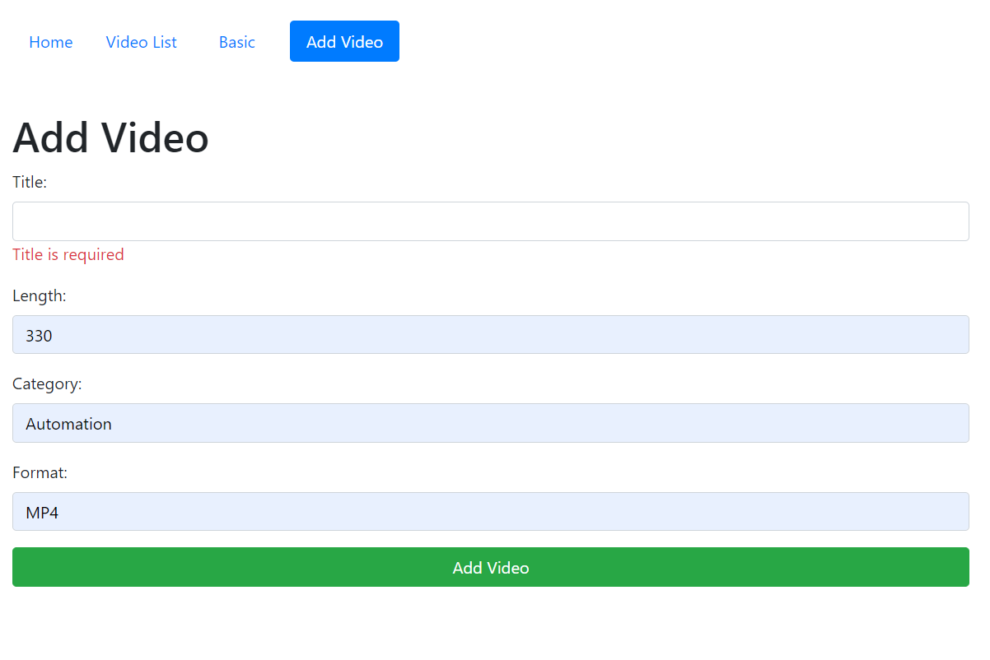

Slide 21
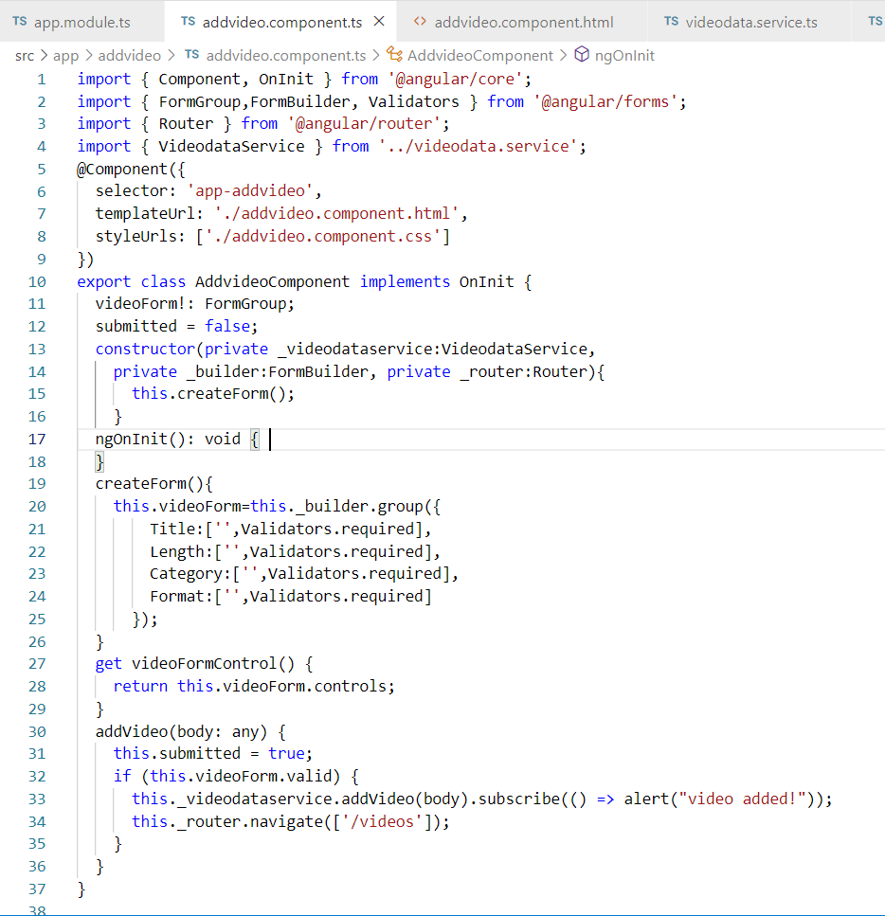

Slide 22
import { Component, OnInit } from '@angular/core';
import { FormGroup,FormBuilder, Validators } from '@angular/forms';
import { Router } from '@angular/router';
import { VideodataService } from '../videodata.service';
@Component({
selector: 'app-addvideo',
templateUrl: './addvideo.component.html',
styleUrls: ['./addvideo.component.css']
})
export class AddvideoComponent implements OnInit {
videoForm!: FormGroup;
submitted = false;
constructor(private _videodataservice:VideodataService,
private _builder:FormBuilder, private _router:Router){
this.createForm();
}
ngOnInit(): void {
}
createForm(){
this.videoForm=this._builder.group({
Title:['',Validators.required],
Length:['',Validators.required],
Category:['',Validators.required],
Format:['',Validators.required]
});
}
get videoFormControl() {
return this.videoForm.controls;
}
addVideo(body: any) {
this.submitted = true;
if (this.videoForm.valid) {
this._videodataservice.addVideo(body).subscribe(() => alert("video added!"));
this._router.navigate(['/videos']);
}
}
}

Slide 23
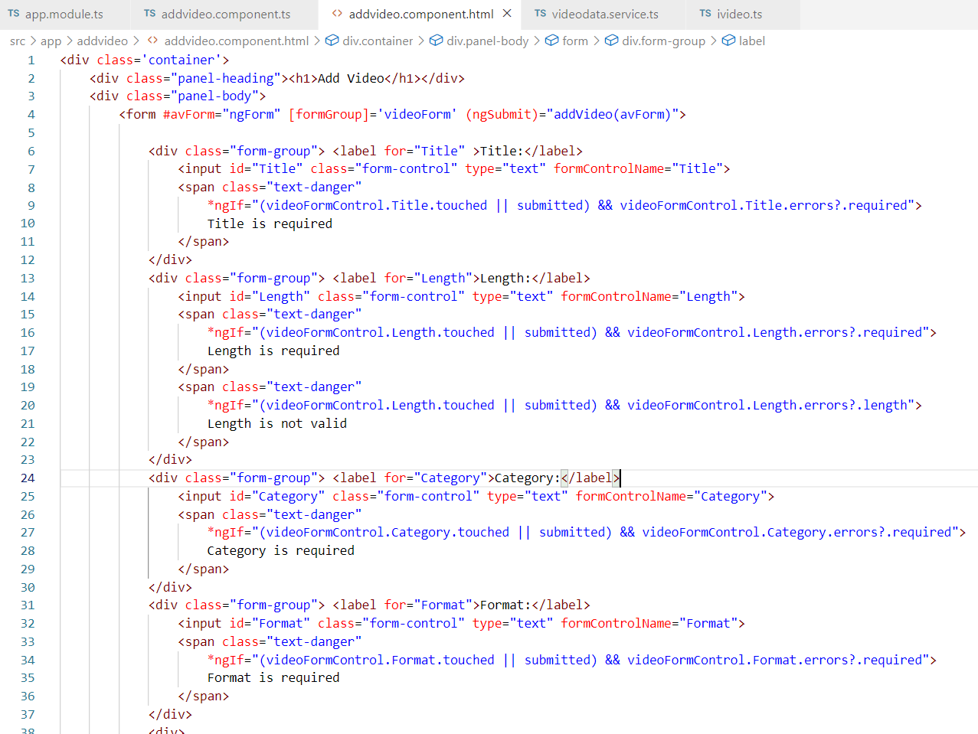

Slide 24
<div class='container'>
<div class="panel-heading"><h1>Add Video</h1></div>
<div class="panel-body">
<form #avForm="ngForm" [formGroup]='videoForm' (ngSubmit)="addVideo(avForm)">
<div class="form-group"> <label for="Title" >Title:</label>
<input id="Title" class="form-control" type="text" formControlName="Title">
<span class="text-danger"
*ngIf="(videoFormControl.Title.touched || submitted) && videoFormControl.Title.errors?.required">
Title is required
</span>
</div>
<div class="form-group"> <label for="Length">Length:</label>
<input id="Length" class="form-control" type="text" formControlName="Length">
<span class="text-danger"
*ngIf="(videoFormControl.Length.touched || submitted) && videoFormControl.Length.errors?.required">
Length is required
</span>
</div>
<div class="form-group"> <label for="Category">Category:</label>
<input id="Category" class="form-control" type="text" formControlName="Category">
<span class="text-danger"
*ngIf="(videoFormControl.Category.touched || submitted) && videoFormControl.Category.errors?.required">
Category is required
</span>
</div>
<div class="form-group"> <label for="Format">Format:</label>
<input id="Format" class="form-control" type="text" formControlName="Format">
<span class="text-danger"
*ngIf="(videoFormControl.Format.touched || submitted) && videoFormControl.Format.errors?.required">
Format is required
</span>
</div>
<div>
<button class="btn btn-success btn-block" type="submit">
Add Video
</button>
</div>
</form>
</div>
</div>

Slide 25
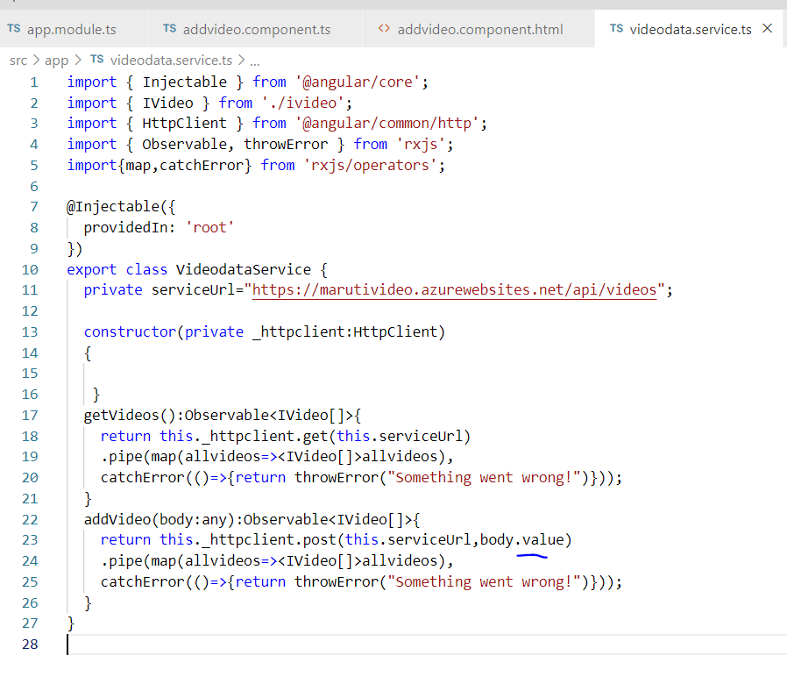

Slide 26

Route Guards?
Helps to protect your route
[before reaching to component]

Slide 27
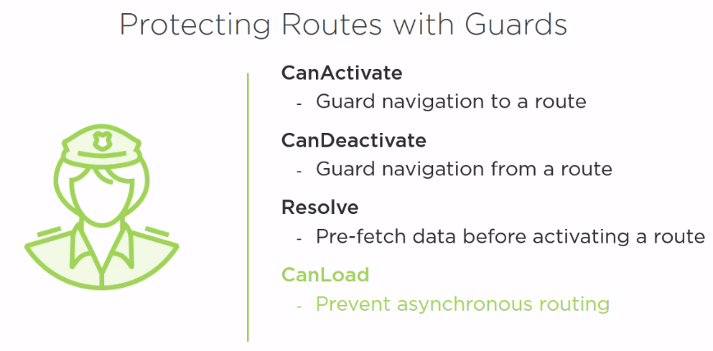

Slide 28
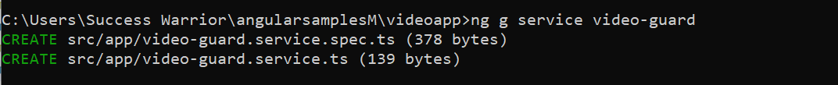
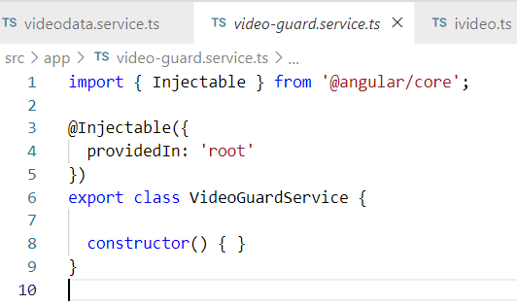

Slide 29
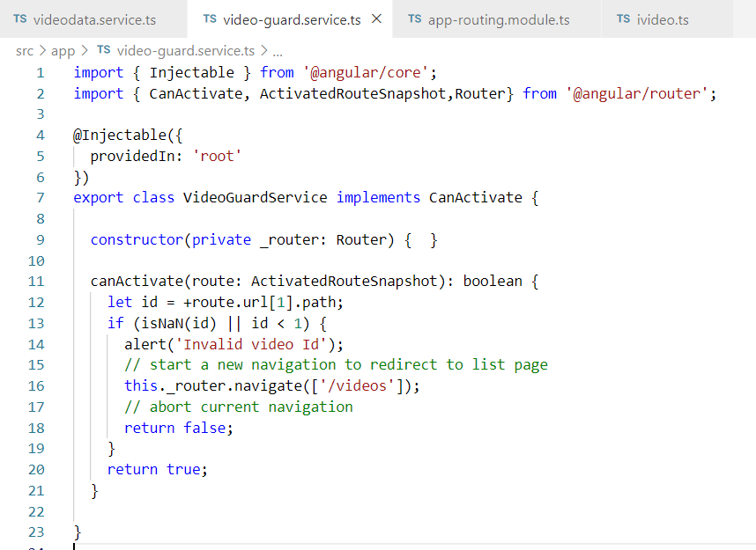

Slide 30
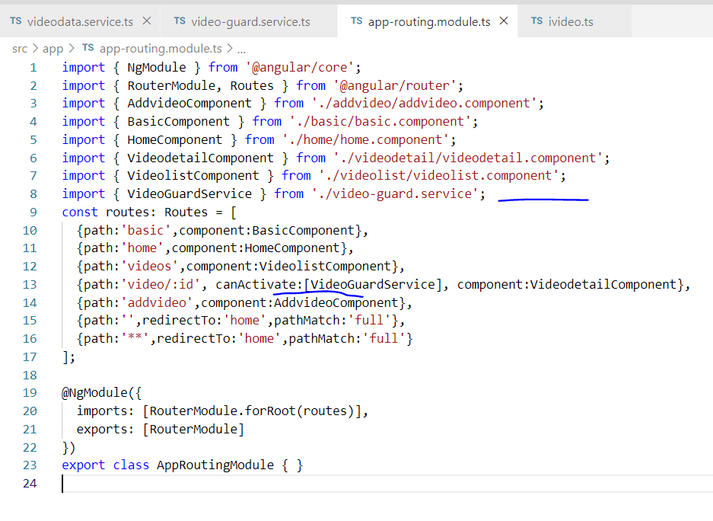

Slide 31
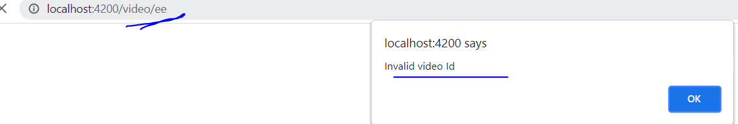

Slide 32
CanDeactivate guard can be used in the scenario, where, suppose a user is changing form data and before saving, user tries to navigate away.
In this scenario we can use CanDeactivate guard which will deactivate the route and open a Dialog Box to take user confirmation

Slide 33
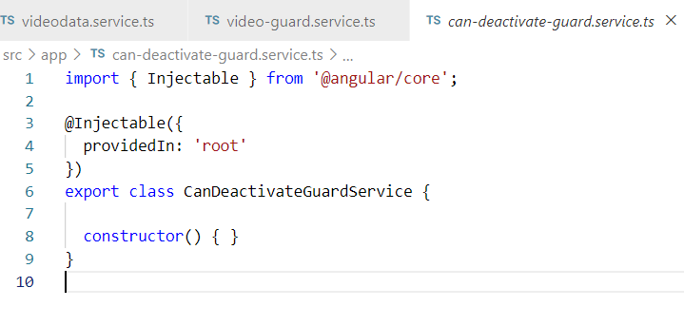

Slide 34
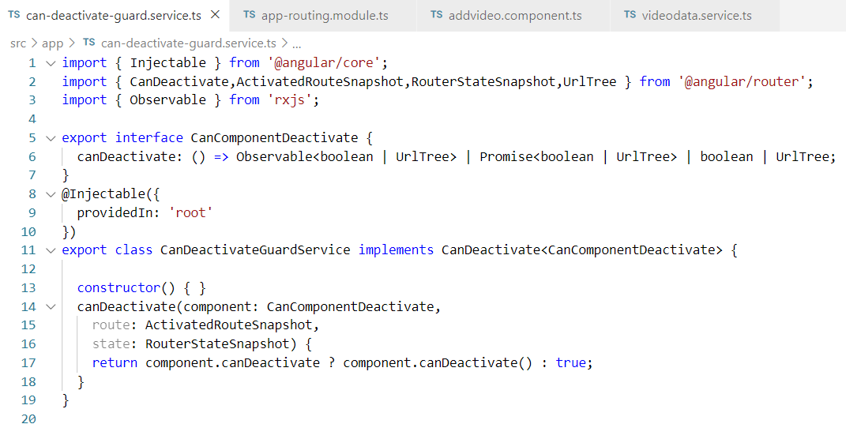

Slide 35
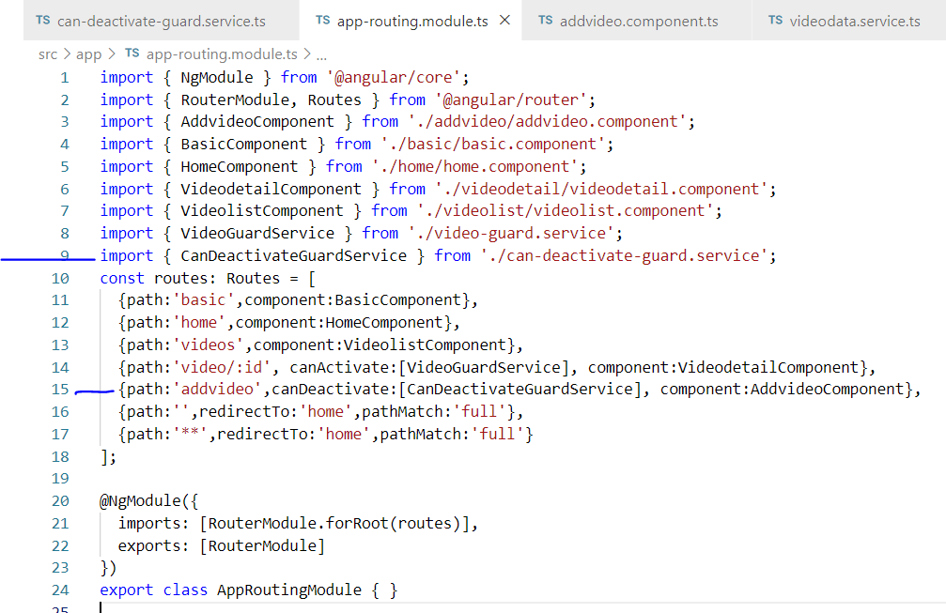

Slide 36
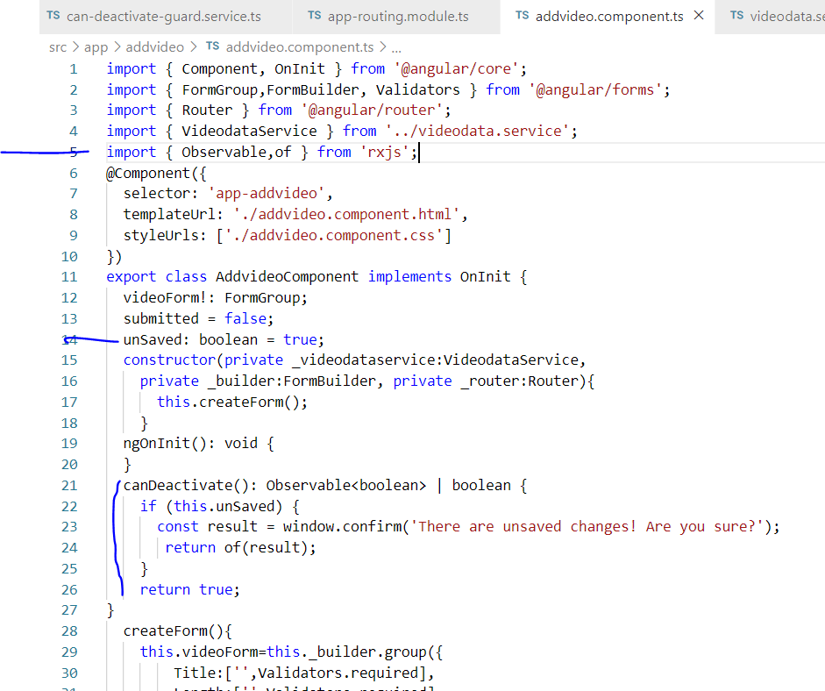

Slide 37
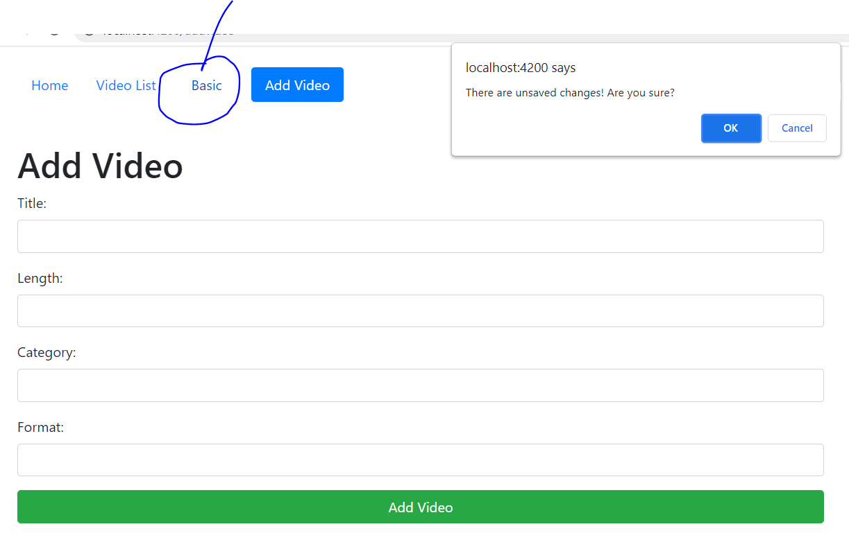

Slide 38

Angular Unit Testing

Slide 39
For testing Angular applications there are certain tools that you should use that will make testing much easier to set up and run.
Karma
Karma is a JavaScript command line tool that can be used to spawn a web server which loads your application's source code and executes your tests.
Karma is a NodeJS application, and should be installed through npm.
Jasmine
Jasmine is a test driven development framework for JavaScript that has become the most popular choice for testing Angular applications. Jasmine provides functions to help with structuring your tests and also making assertions. As your tests grow, keeping them well structured and documented is vital, and Jasmine helps achieve this.

Slide 40
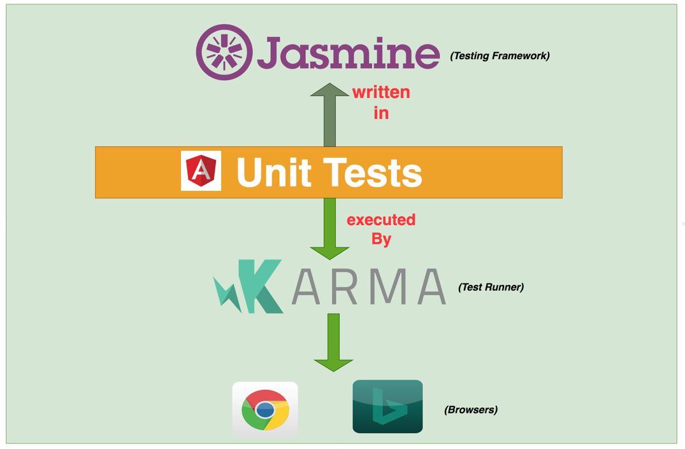

Slide 41
Suites: describe Your Tests
A test suite begins with a call to the global Jasmine function describe with two parameters: a string and a function. The string is a name or title for a spec suite – usually what is under test. The function is a block of code that implements the suite.
Specs
Specs are defined by calling the global Jasmine function it, which, like describe takes a string and a function. The string is a title for this spec and the function is the spec, or test. A spec contains one or more expectations that test the state of the code under test.
An expectation in Jasmine is an assertion that can be either true or false. A spec with all true expectations is a passing spec. A spec with one or more expectations that evaluate to false is a failing spec.

Slide 42
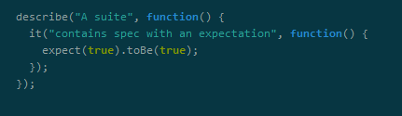

Slide 43
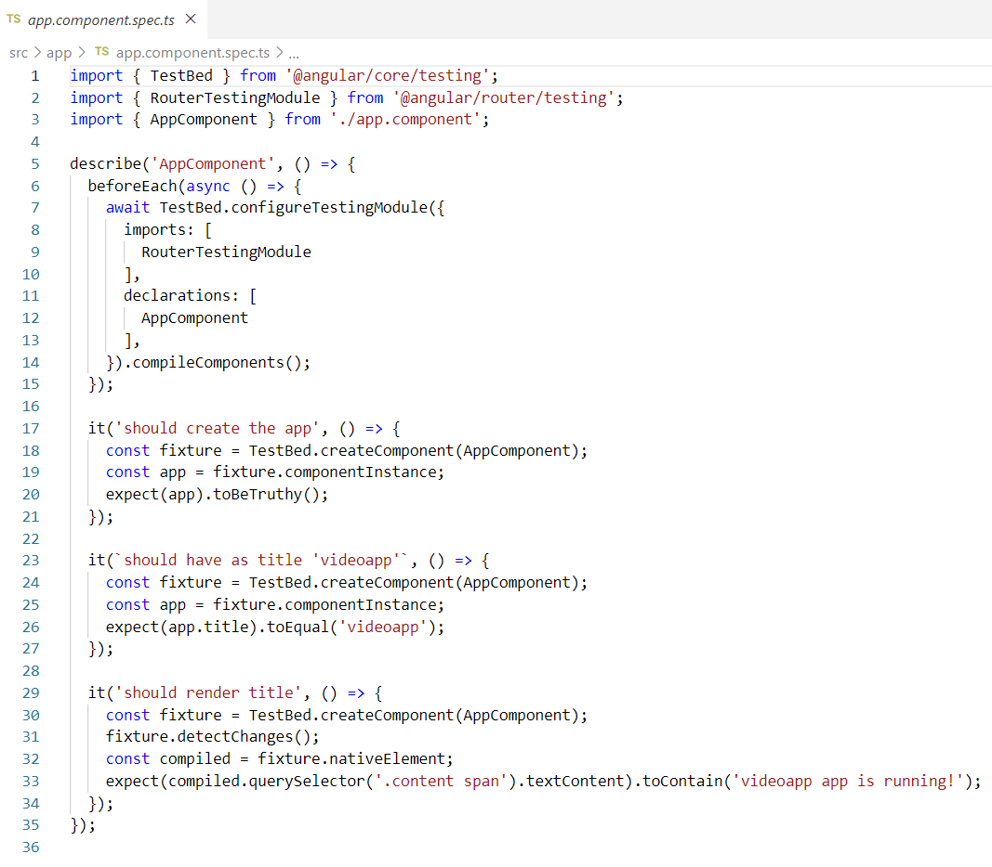

Slide 44
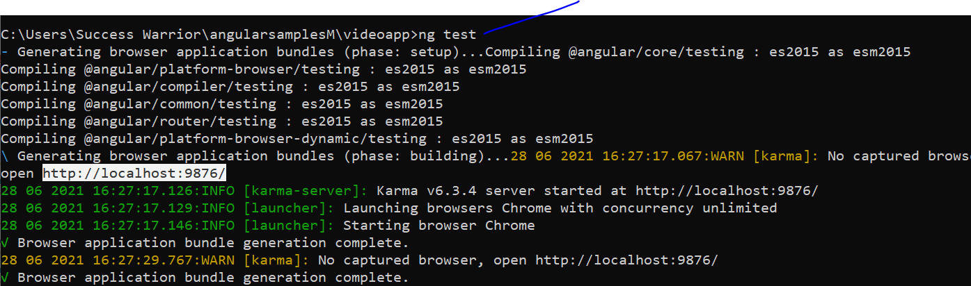

Slide 45
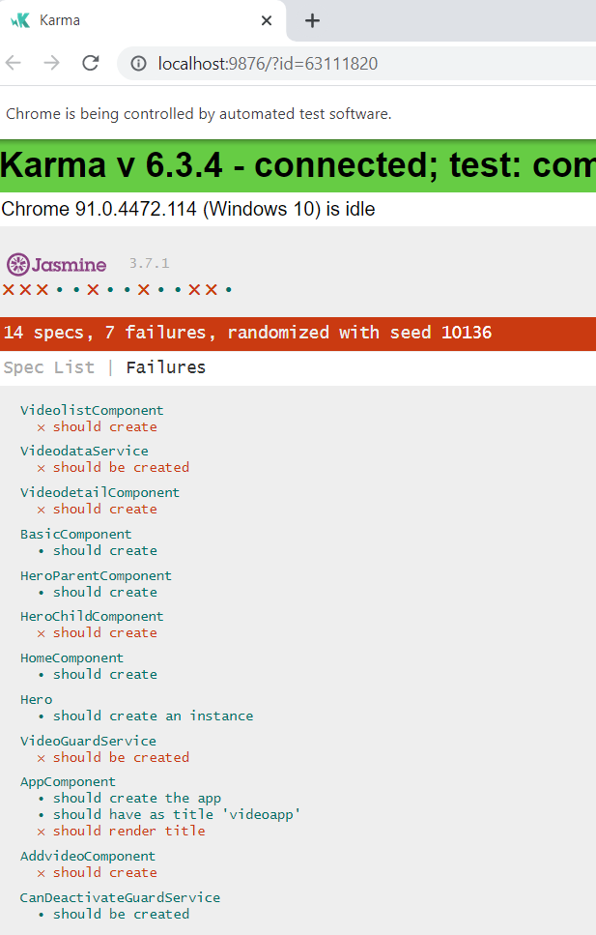

Slide 46
This is failing because we don’t have any span tag

Slide 47
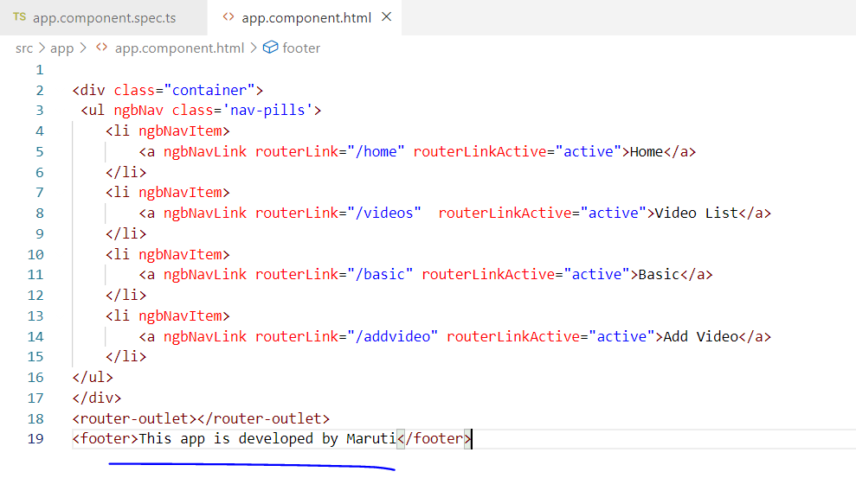

Slide 48
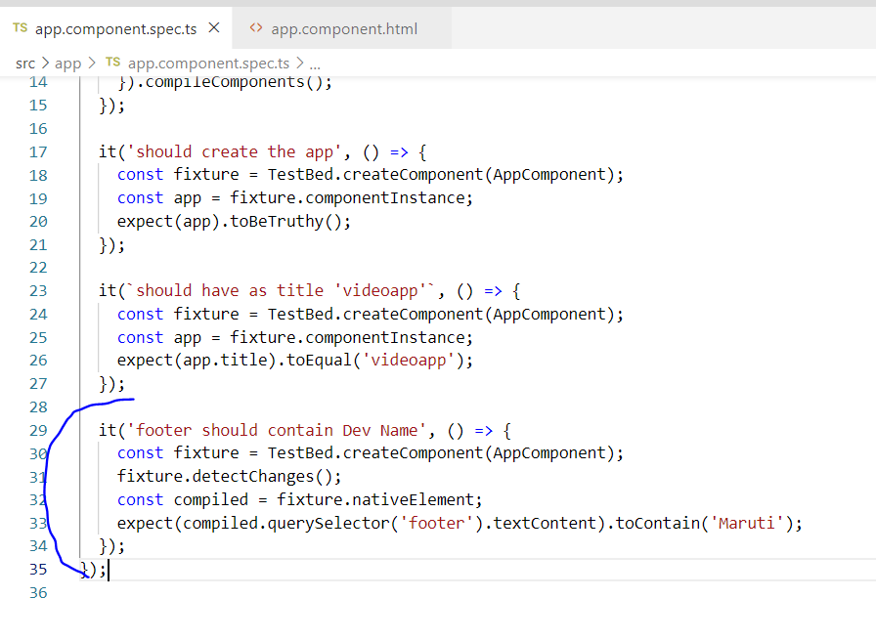

Slide 49
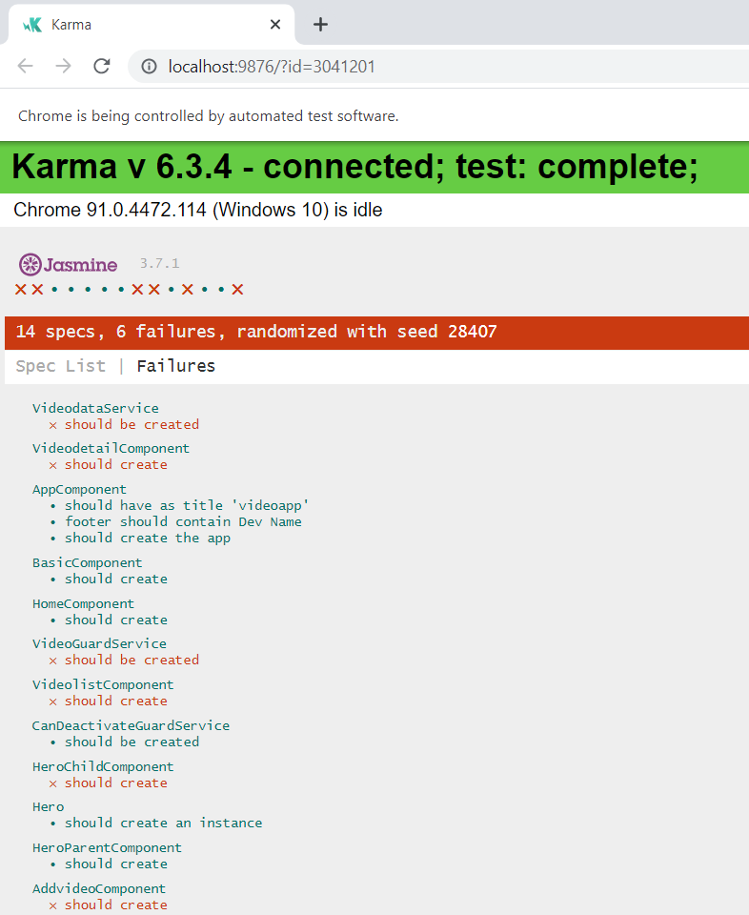
Now you should have
6 failures

Slide 50
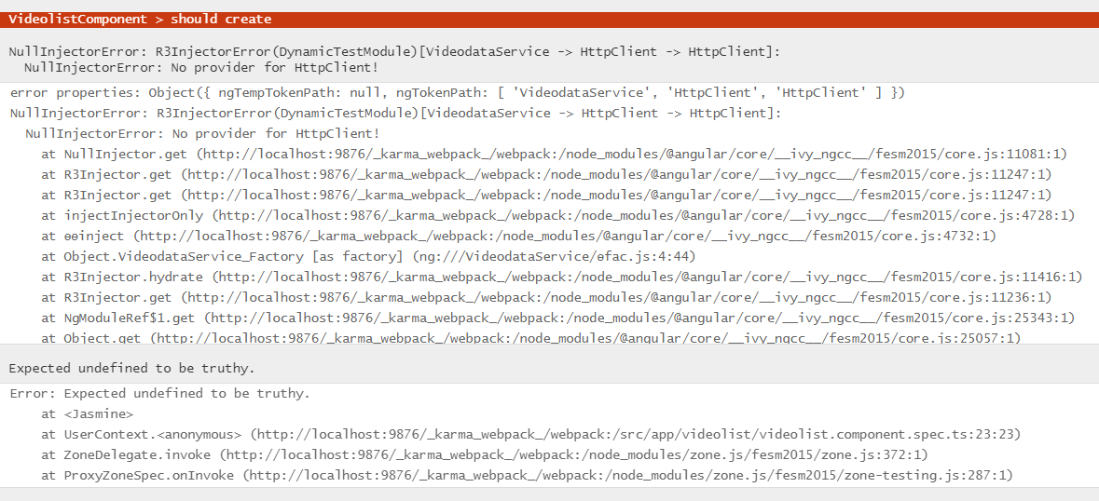
Now let’s fix this

Slide 51
If there is no provider for httpClient then
How my project code is running fine???

Slide 52
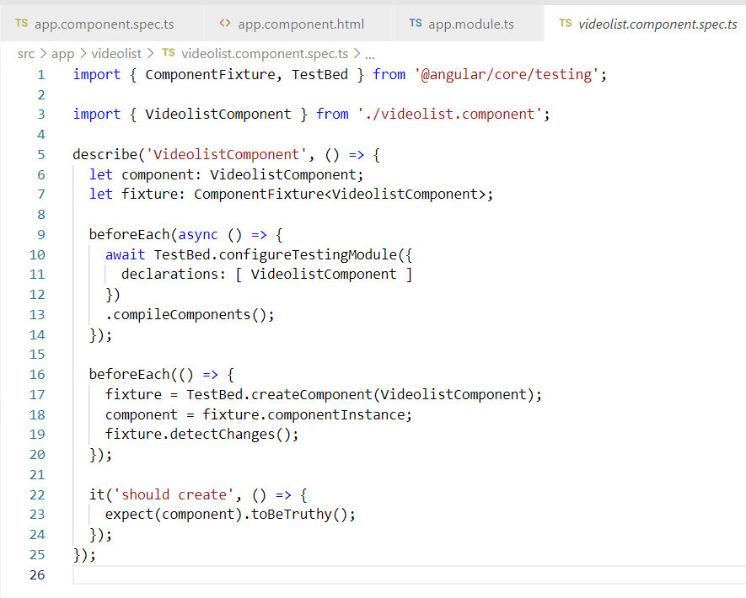
Because in test
We don’t have
Any provider for
httpClient

Slide 53
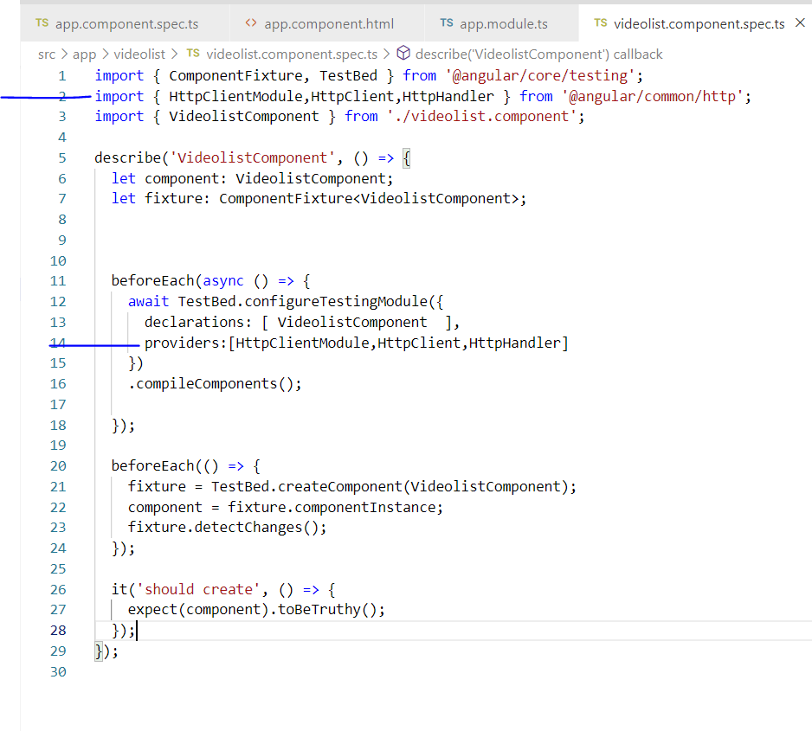

Slide 54
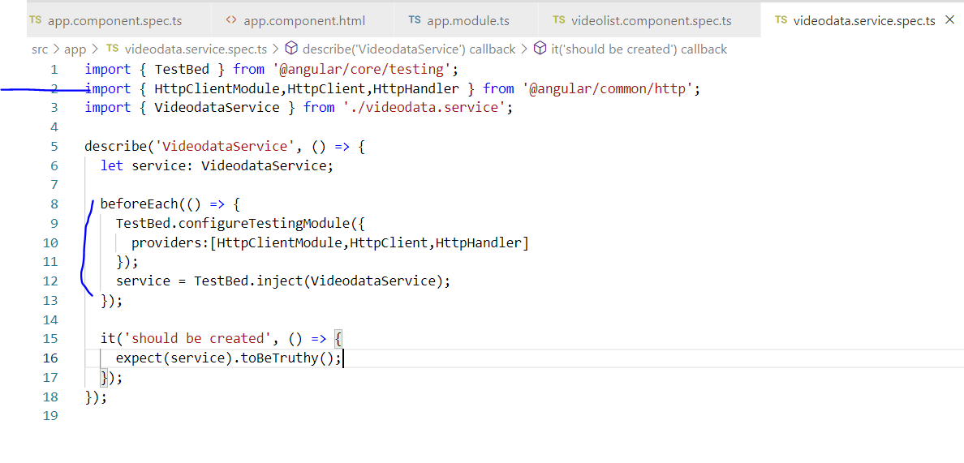

Slide 55
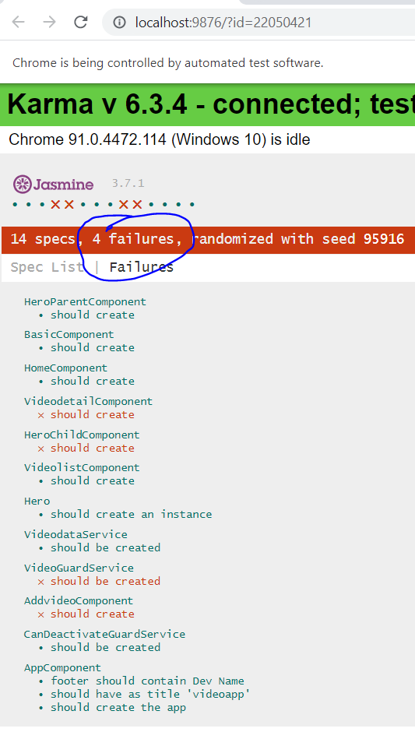

Slide 56
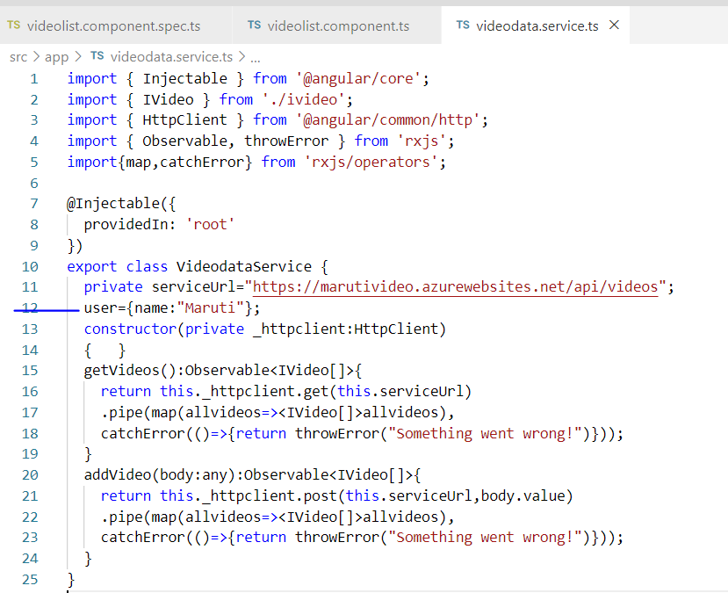

Slide 57
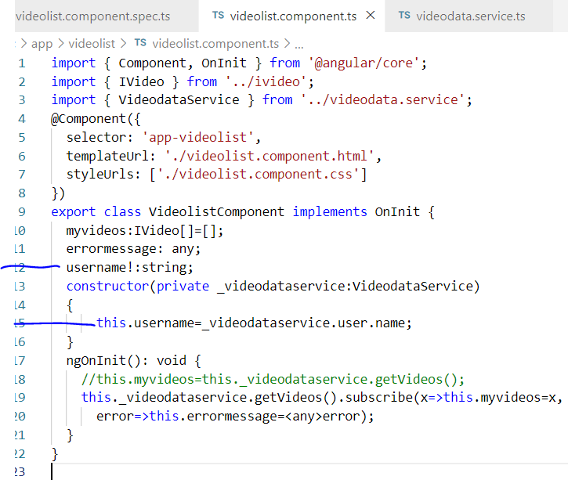

Slide 58
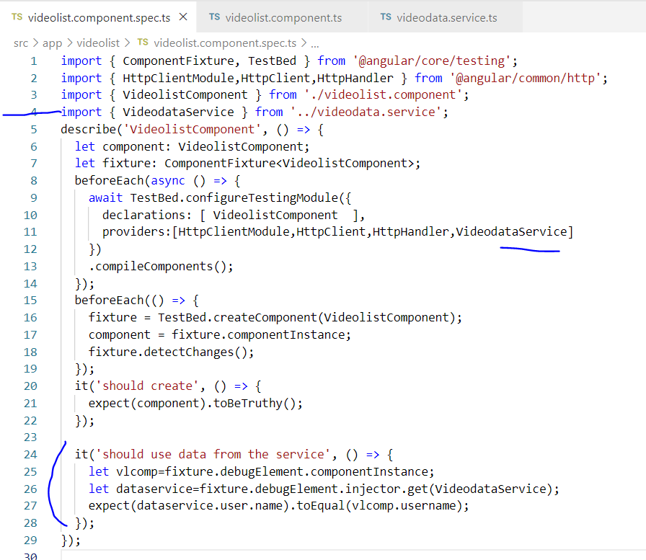

Slide 59
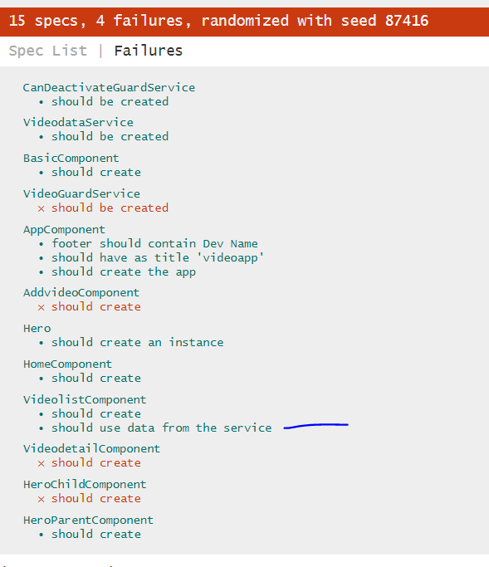

Slide 60
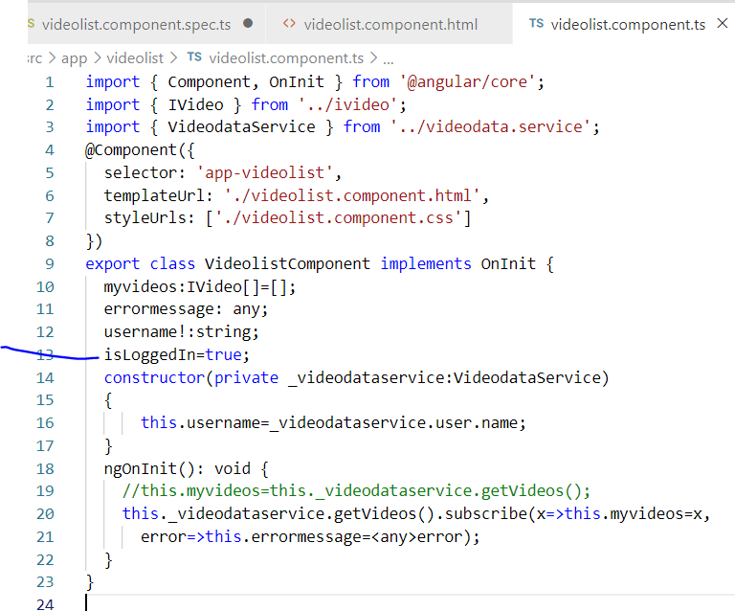

Slide 61
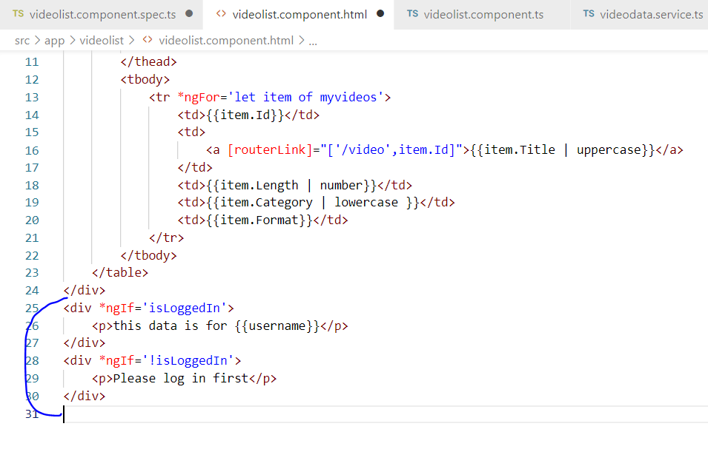

Slide 62
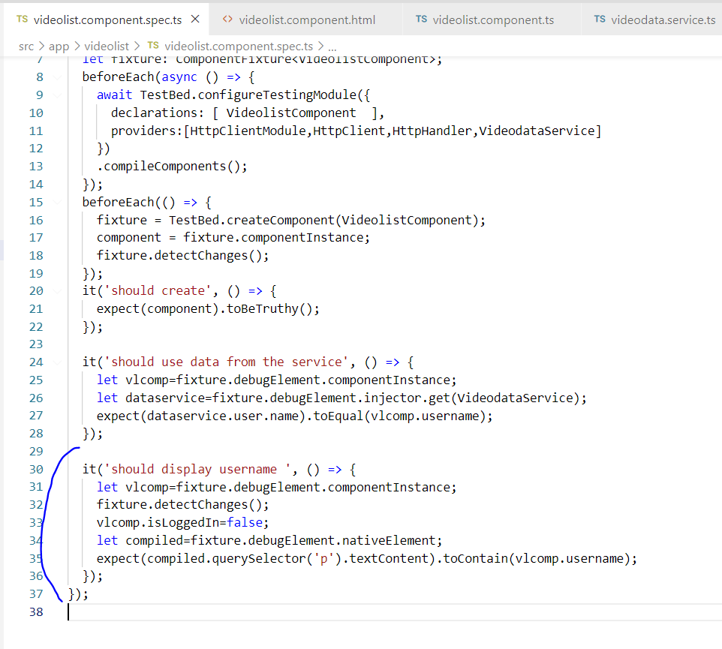

Slide 63


Slide 64


Slide 65


Slide 66


Slide 67


